Slide 1

Data Science Skills Query
Skill query dashboard to help analyze different careers in data science based on various aspects.

Slide 2
Technologies Used
Python
Pandas
Jupyter-dash
Plotly

Slide 3
Data Pulled from:
Kaggle

Slide 4

Data Science Aspects Analyzed
Job Title
Salary
Employee Residence
Employee Location
Experience Level
Company Location
Remote ratio

Slide 5
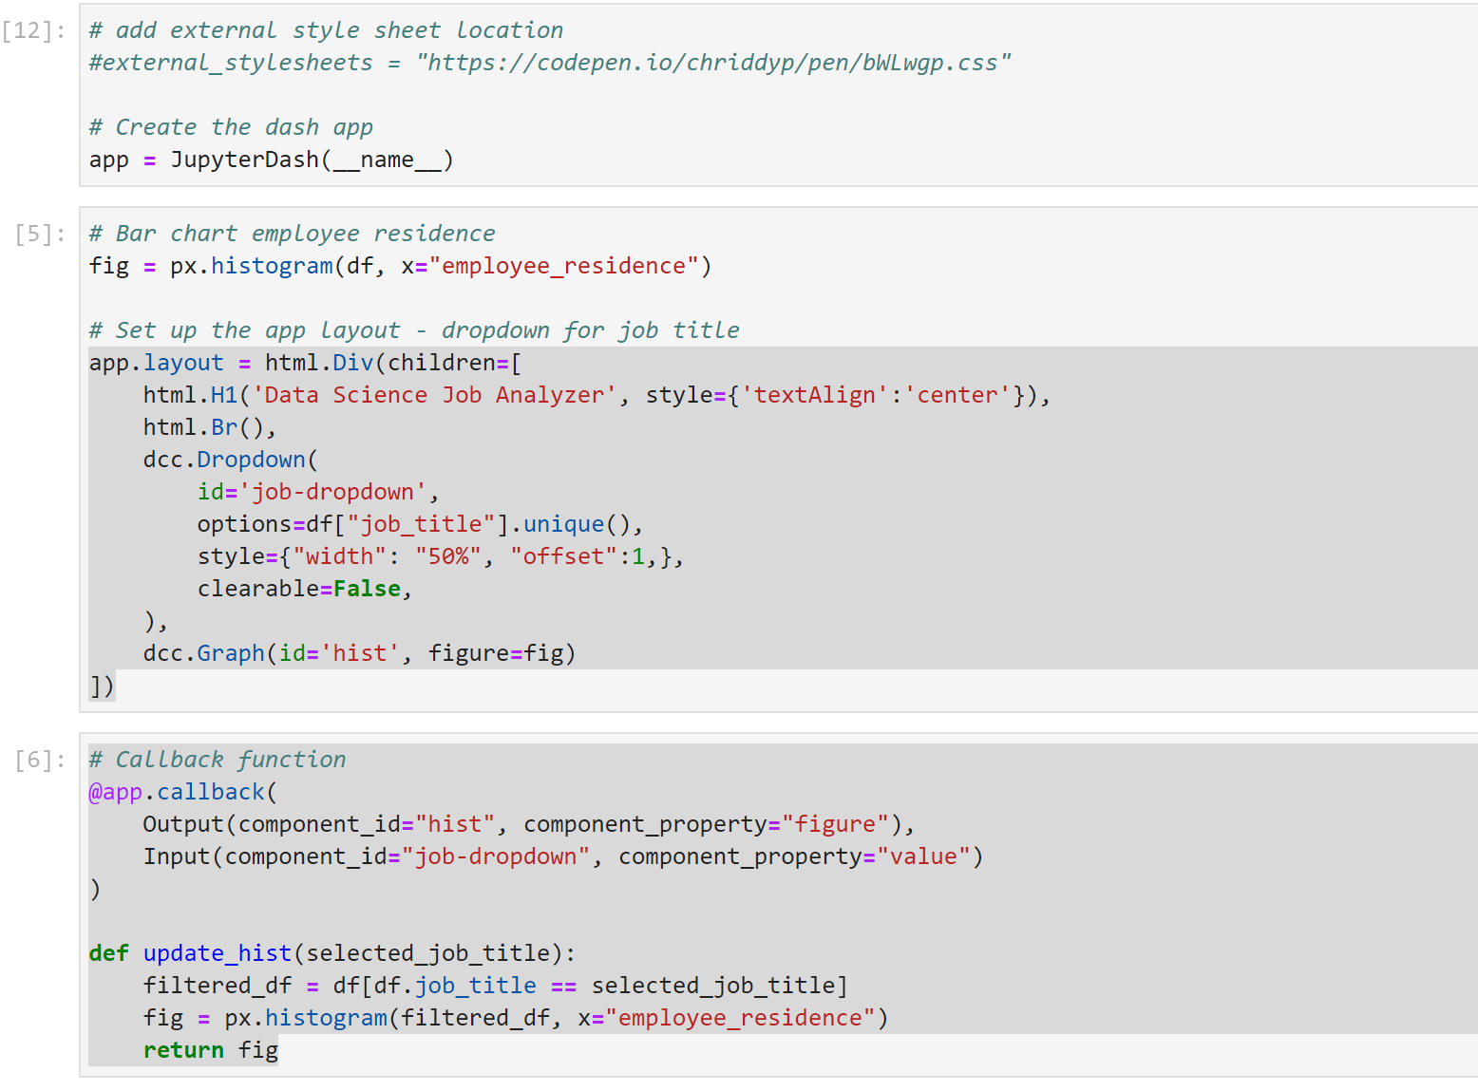
RedditScraper.py

Slide 6
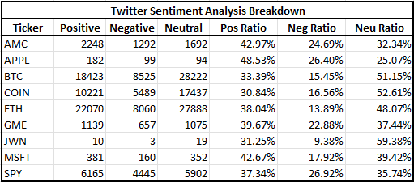
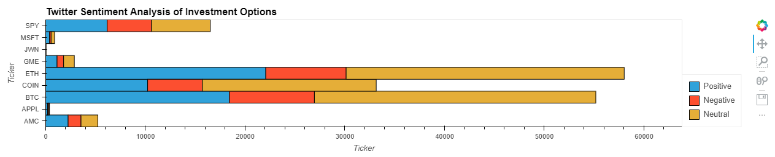
Graphs

Slide 7
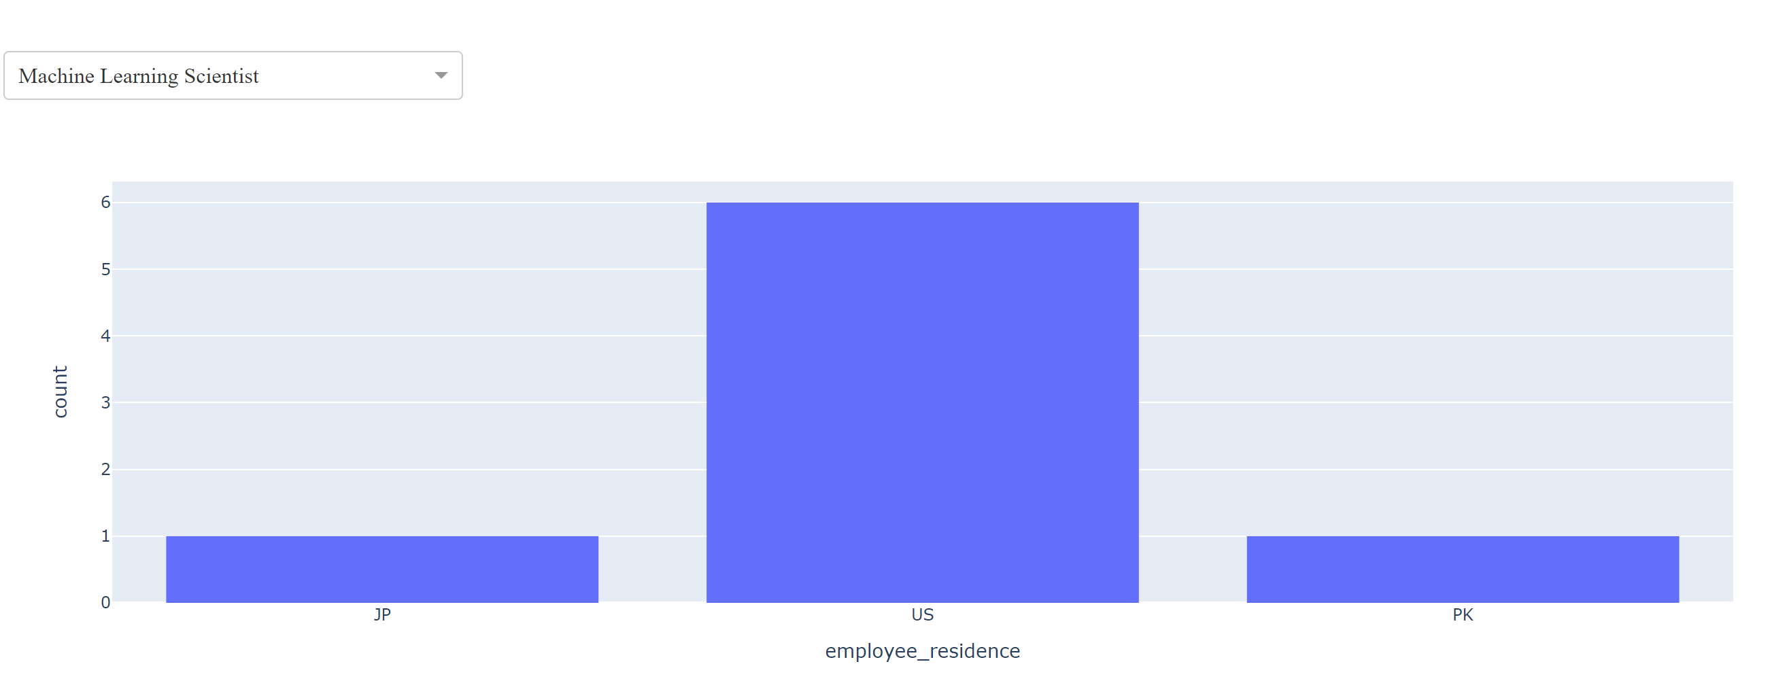
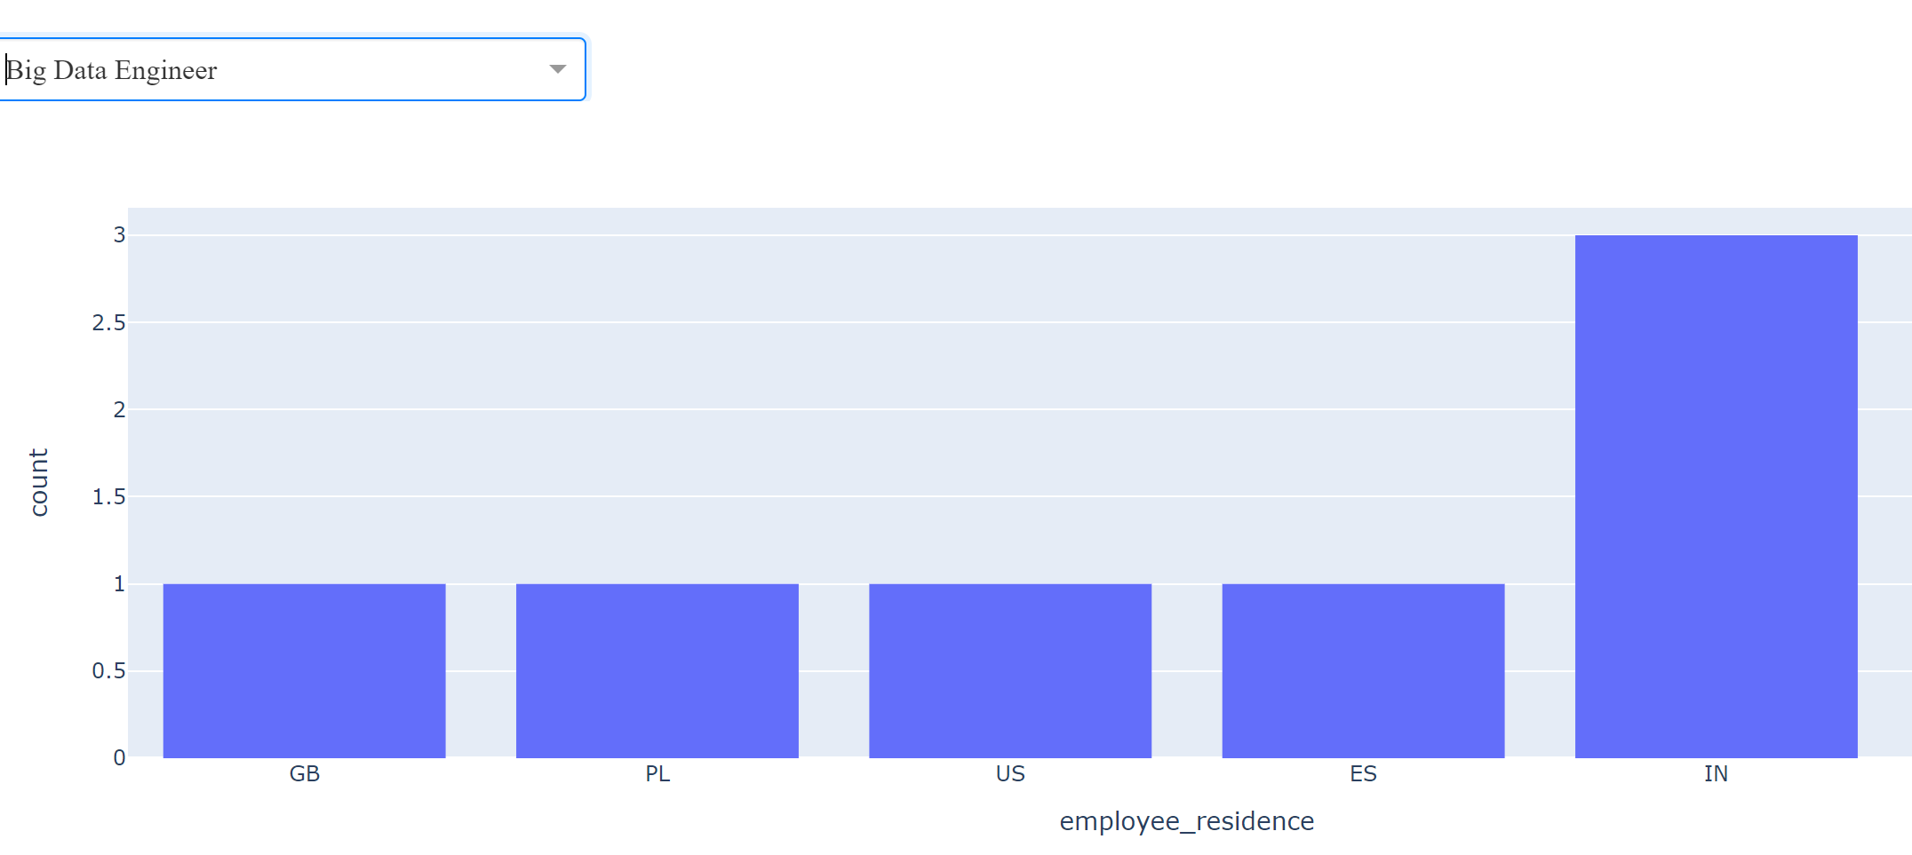
Graphs

Slide 8
Challenges
Scope of project became larger than initially planned, making it difficult to stay on schedule
Implementing a new library and coding around it was challenging and required more time as it involved understanding a new concept (html)
It was challenging finding data with similar aspects to analyze hence the reliance on just one year.

Slide 9

Future Goals Collect data that covers more years to create a better dashboard . Incorporate more jupyter dash components for analysis

